Slide 1

Unit 2: Op-Amp Applications
Applications of Op-amp
Voltage follower, Summing/Difference amplifier, Integrator/Differentiator
Pre – preparation: Lecture Materials and LIC Text book by ROY Choudhury, sixth edition, 2022.

Slide 2
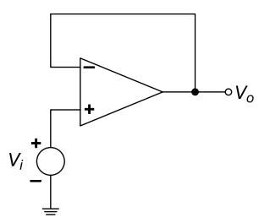
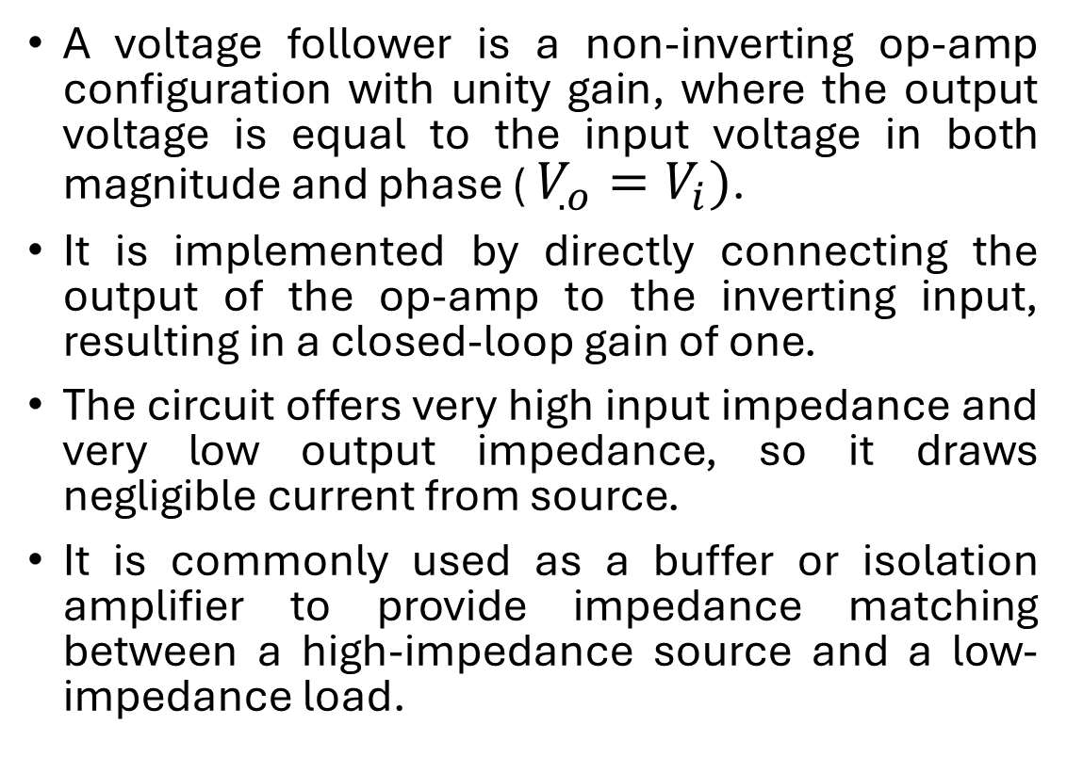
Voltage follower
A voltage follower is a non-inverting op-amp configuration with unity gain, where the output voltage is equal to the input voltage in both magnitude and phase ( $V_{.o}=V_{i})$.
It is implemented by directly connecting the output of the op-amp to the inverting input, resulting in a closed-loop gain of one.
The circuit offers very high input impedance and very low output impedance, so it draws negligible current from source.
It is commonly used as a buffer or isolation amplifier to provide impedance matching between a high-impedance source and a low-impedance load.

Slide 3
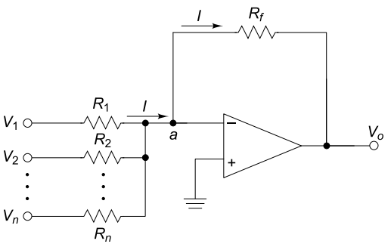

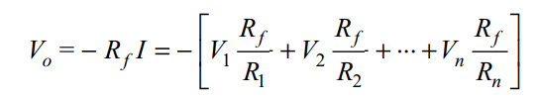
Summing amplifier
A summing amplifier (adder) is an inverting op-amp configuration whose output is the algebraic sum of multiple input signals.
If all input resistors are equal (𝑅1=𝑅2=⋯=𝑅𝑛), the circuit becomes an equal-weighted summing amplifier.
Each input has an independent gain determined by its input resistor, with minimal interaction between inputs.
Common applications include audio mixing, signal combining, and level shifting (adding a DC offset to an AC signal).

Slide 4
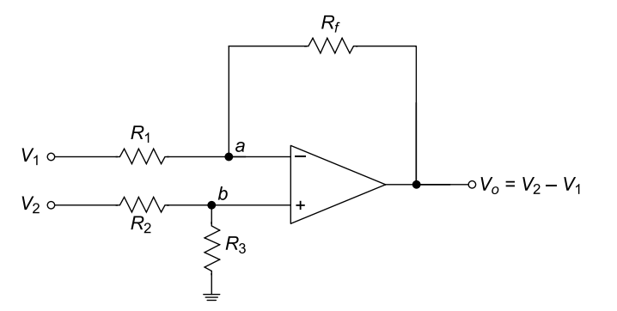



Subtractor amplifier
A subtractor (difference amplifier) is realized using an op-amp with four equal resistors 𝑅1=𝑅2=𝑅3=𝑅𝑓.
Using the superposition principle, the output due to 𝑉2​ alone acts as a unity-gain non-inverting amplifier, while the output due to 𝑉1​ alone acts as a unity-gain inverting amplifier.
Hence, the circuit produces an output proportional to the difference between the two input voltages and functions as a unity-gain difference (subtractor) amplifier.

Slide 5
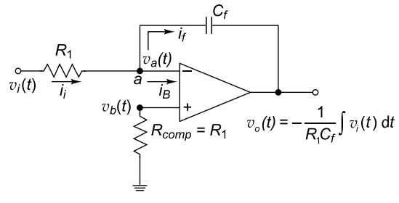
Integrator
An op-amp integrator is obtained by replacing the feedback resistor of an inverting amplifier with a capacitor 𝐶𝑓.
Due to virtual ground at the inverting input and negligible input bias current, the output voltage is proportional to the negative time integral of the input voltage.
At DC (𝜔=0), the gain becomes theoretically infinite, causing output saturation in practical circuits, while higher frequencies produce stable integration behavior.

Slide 6





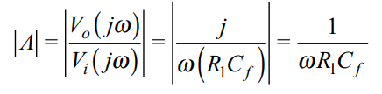


Slide 7
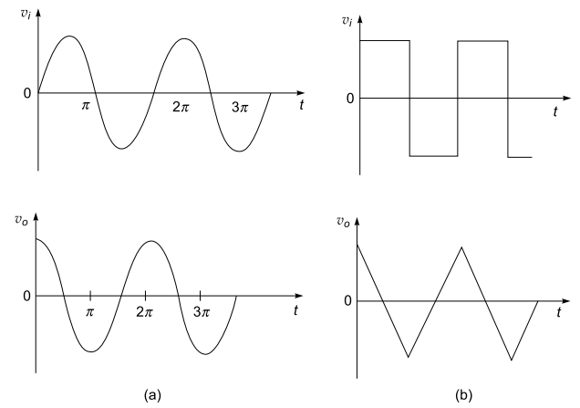
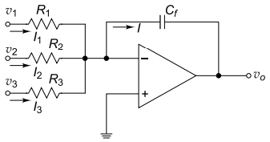


Slide 8
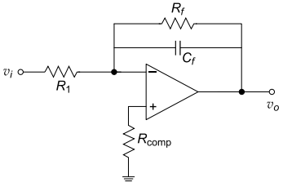
Limitations of Ideal integrator:
In an ideal op-amp integrator, even in the absence of an input signal, input offset voltage and bias current produce an error voltage at the output, causing distortion and preventing true integration.
To limit low-frequency gain and avoid saturation, a resistor is connected in parallel with the integrating capacitor, but this also restricts the high-frequency integration range, making the circuit non-ideal.
Because of these limitations, a practical integrator is used, where errors due to offset, bias current, and drift are minimized using compensation resistors,

Slide 9
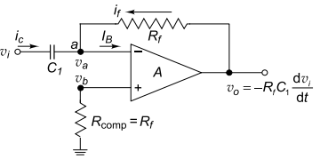



Differentiator
An op-amp differentiator produces an output voltage proportional to the rate of change of the input voltage, making it useful for detecting rapid signal variations.
The ideal differentiator is obtained by replacing the input resistor of an inverting amplifier with a capacitor, effectively interchanging the resistor and capacitor positions of an integrator.
A differentiator performs the inverse operation of an integrator and emphasizes high-frequency components, with the upper cut-off frequency determined by the RC time constant.

Slide 10
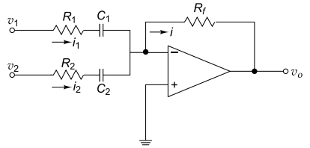
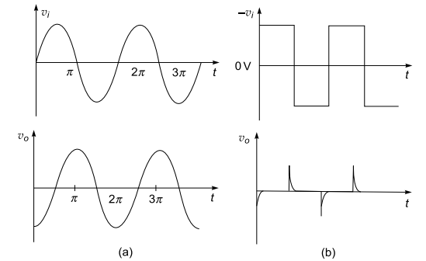


Slide 11
Practice numericals

Slide 12
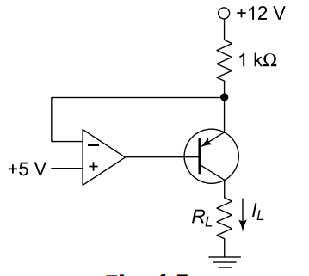

Determine the output current IL for the circuit shown in Fig.
Potential at emitter by virtual ground=5V.
Using KVL analysis current through 1kohm resistor is

Slide 13
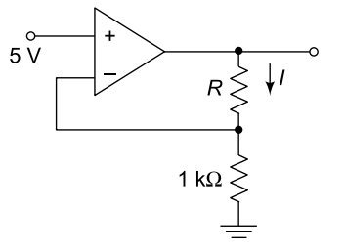
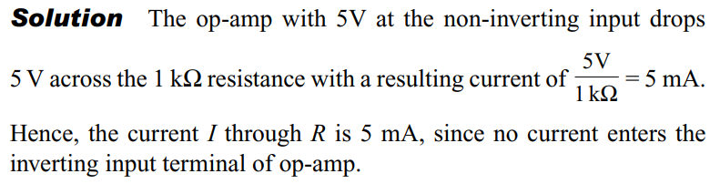
Determine the current I in the circuit shown in Fig

Slide 14
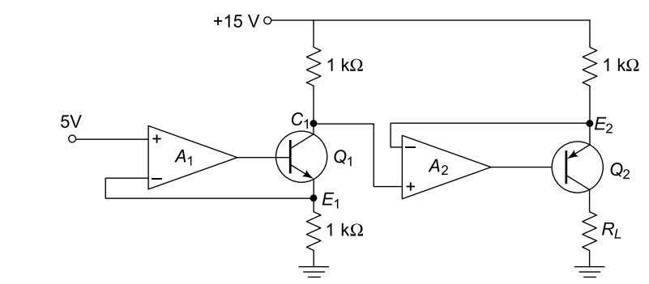

Determine the current through RL in the circuit shown in Fig

Slide 15
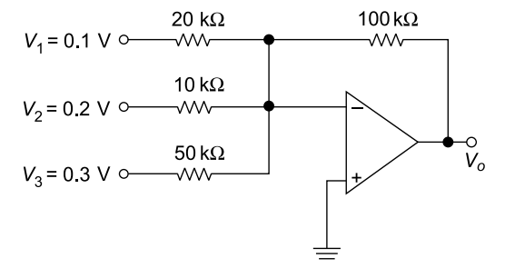
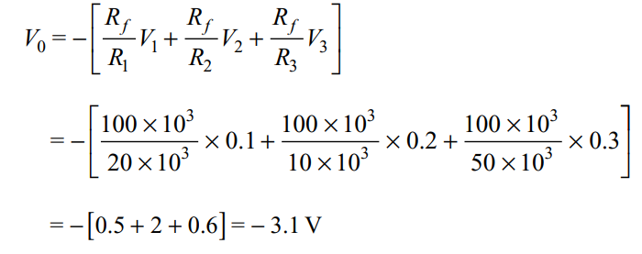
Determine the V0 for the circuit shown in Fig

Slide 16

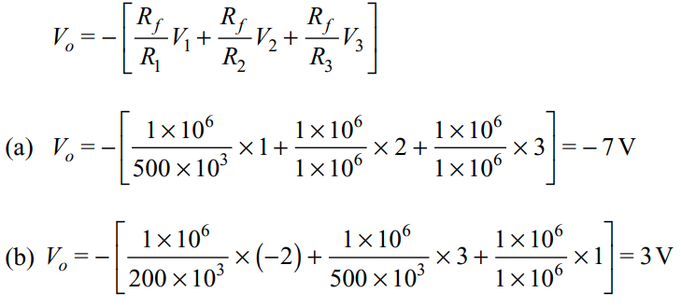
Calculate the output voltage of an op-amp summing amplifier for the following sets of input voltages V1, V2 and V3 and input resistors R1, R2 and R3. Use R1=1Mohm.

Slide 17
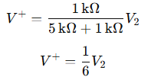
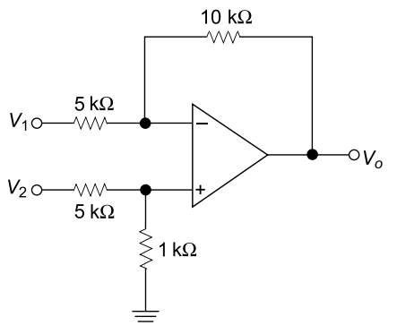

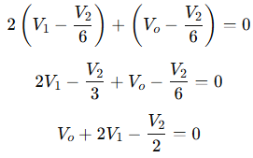

Find the output voltage of the following op-amp circuit shown in Fig.

Slide 18
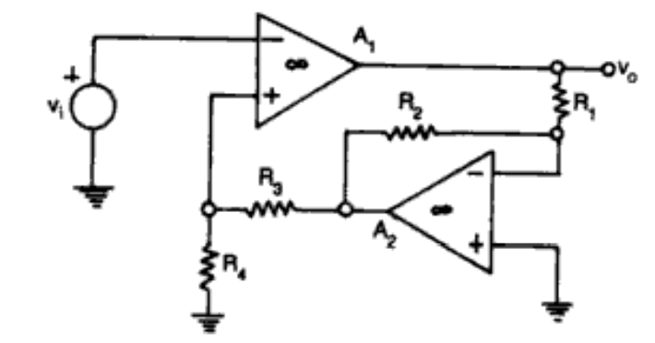
Find gain of the following Op-amp

Slide 19
